Slide 1
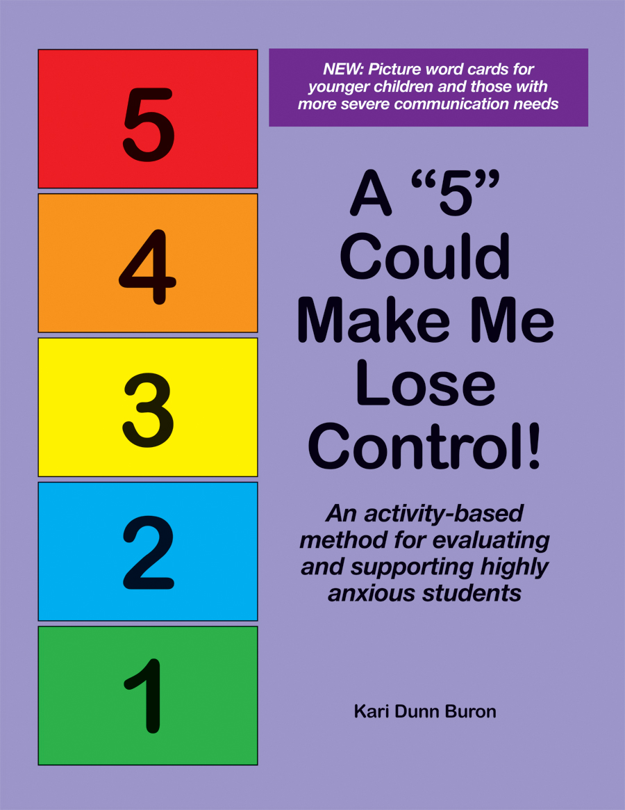
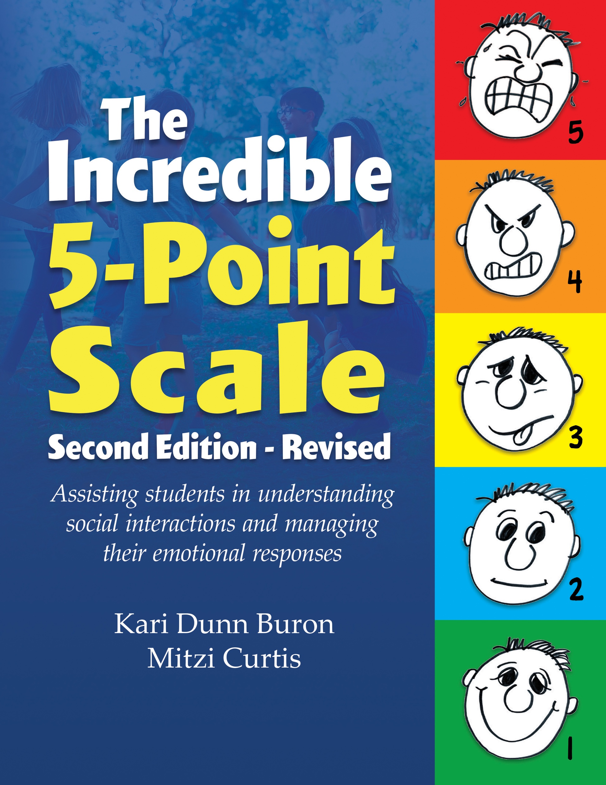
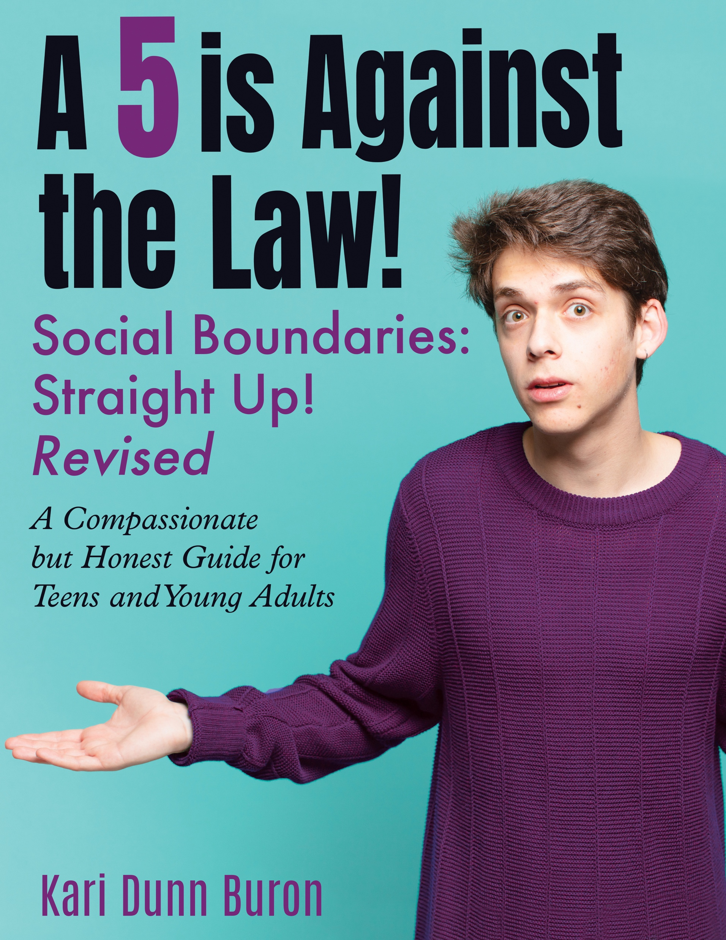
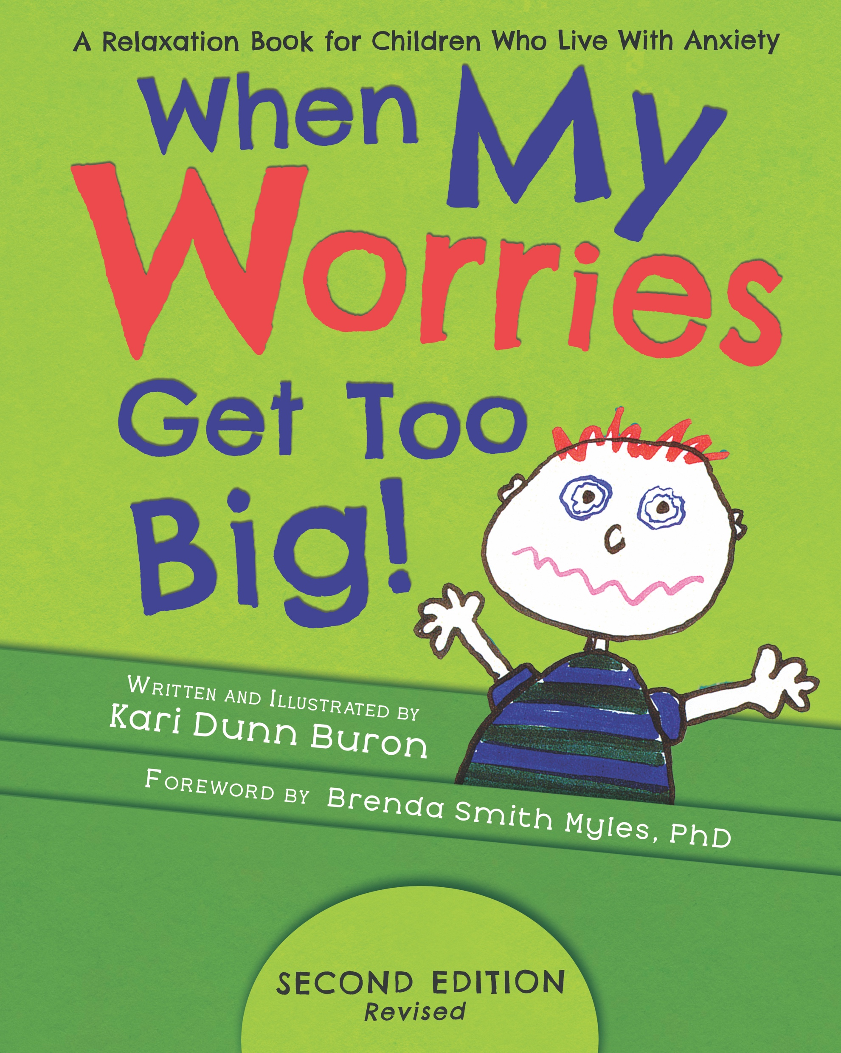
Kari Dunn Buron
www.5pointscale.com
5 Point Scale Publishing

Slide 2
The Incredible 5-Point Scale
A visual system used to teach social and emotional concepts
Addresses Social Cognition and Emotional Regulation
Is not a “level” system
The scale is a highly structured “teaching” method

Slide 3
The 5-Point Scale is based on:
Simon Baron Cohen’s Highly systemized thinking theory
Cognitive Behavior Therapy (CBT)
Cognitive reappraisal/re-think your thinks
Identified Emotional Regulation skills
Visual/Structured teaching

Slide 4
“Numbers are my first
language, one I often think
and feel in.”
Daniel Tammet
Born on a Blue Day

Slide 5
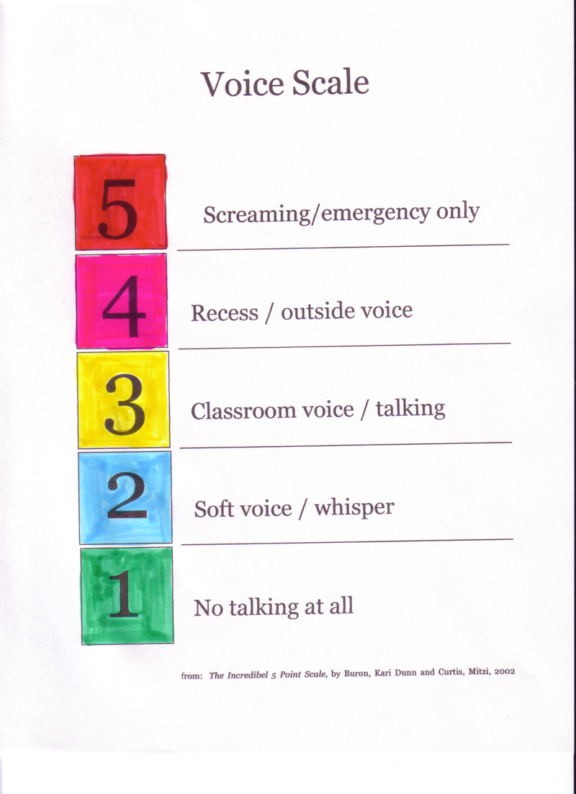
It started here

Slide 6
Using the Check in Scale
Arrival; Before lunch; Before leaving
Initially just have students check in to get used to the routine
Staff check in too
Use numbers to describe what you are seeing in an objective way.
Use numbers to describe how you are feeling – your body and emotions.

Slide 7
Engaging participation

Slide 8
A 5-Point Scale:
Breaks difficult concepts into 5 parts
Can be introduced with a story
Can be made small (business card size) to carry and generalize
Should be reviewed prior to predictably difficult moments
Can be introduced through a video

Slide 9
This Leads to Shared language
At home a 3 voice is expected and sometimes a 4 but at Grandma’s house, she likes a 3 or even a 2 voice.
A 3 is OK before the religious service, but when it starts, we have to try really hard to keep it at a 1.
All common environments can use the same scale and give the different types of voice volume as examples of when and where.

Slide 10
The Incredible 5-Point Scale is a Teaching System

Slide 11
School-wide movement scale
5 = Running: fast; outside; on the field
4 = Fast walking: if you are late; caution!
3 = Walking: This is OK in the hallway
2 = Slow walking: OK but watch the time
1 = No moving at all: good for classroom work time. Sitting in the lunchroom

Slide 12
Problem Scale example:
  5 = Horrible problem!!!
  (emergency)
  4 = Serious problem!
  (I definitely need help)
  3 = Difficult problem
  (I might need help)
  2 = Unfortunate problem…
  (this might take some time)
  1 = No problem ☺

Slide 13
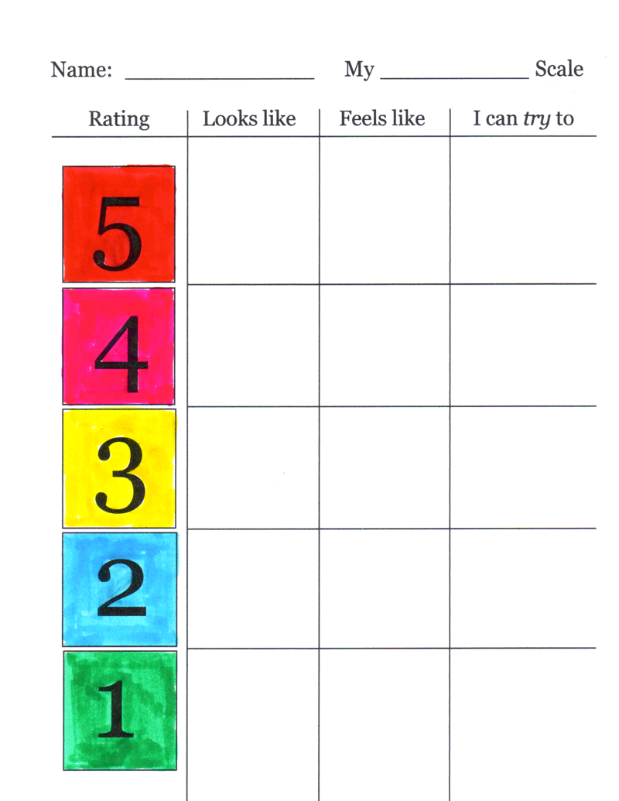

Slide 14
Emotion Regulation
The ability to control the outcome of ones’ emotions
To keep the level of emotions, both positive and negative, in check in order to achieve a goal

Slide 15
Poor emotion regulation may be inherent in autism and may provide the simplest conceptualization for the many associated socioemotional and behavioral problems.
Mazefsky et al.

Slide 16
When Anxiety and Worries enter the picture
Anxiety Is the most contagious of all human emotions
Behavior is personal
Educational teams need an objective, highly systemized plan for addressing upsetting behavior
The anxiety curve can be used to develop such a plan

Slide 17
What do we do with anxiety?
Recognize it.
Know that it is contagious.
Know that learning does not happen when you are in a state of high anxiety.
Know that it is physically harmful to experience chronic anxiety.
Do something about it.

Slide 19
“Under stress the brain favors rigid habit memory over more flexible cognitive memory.”
Dr. Margaret Schmidt, Biologist

Slide 20
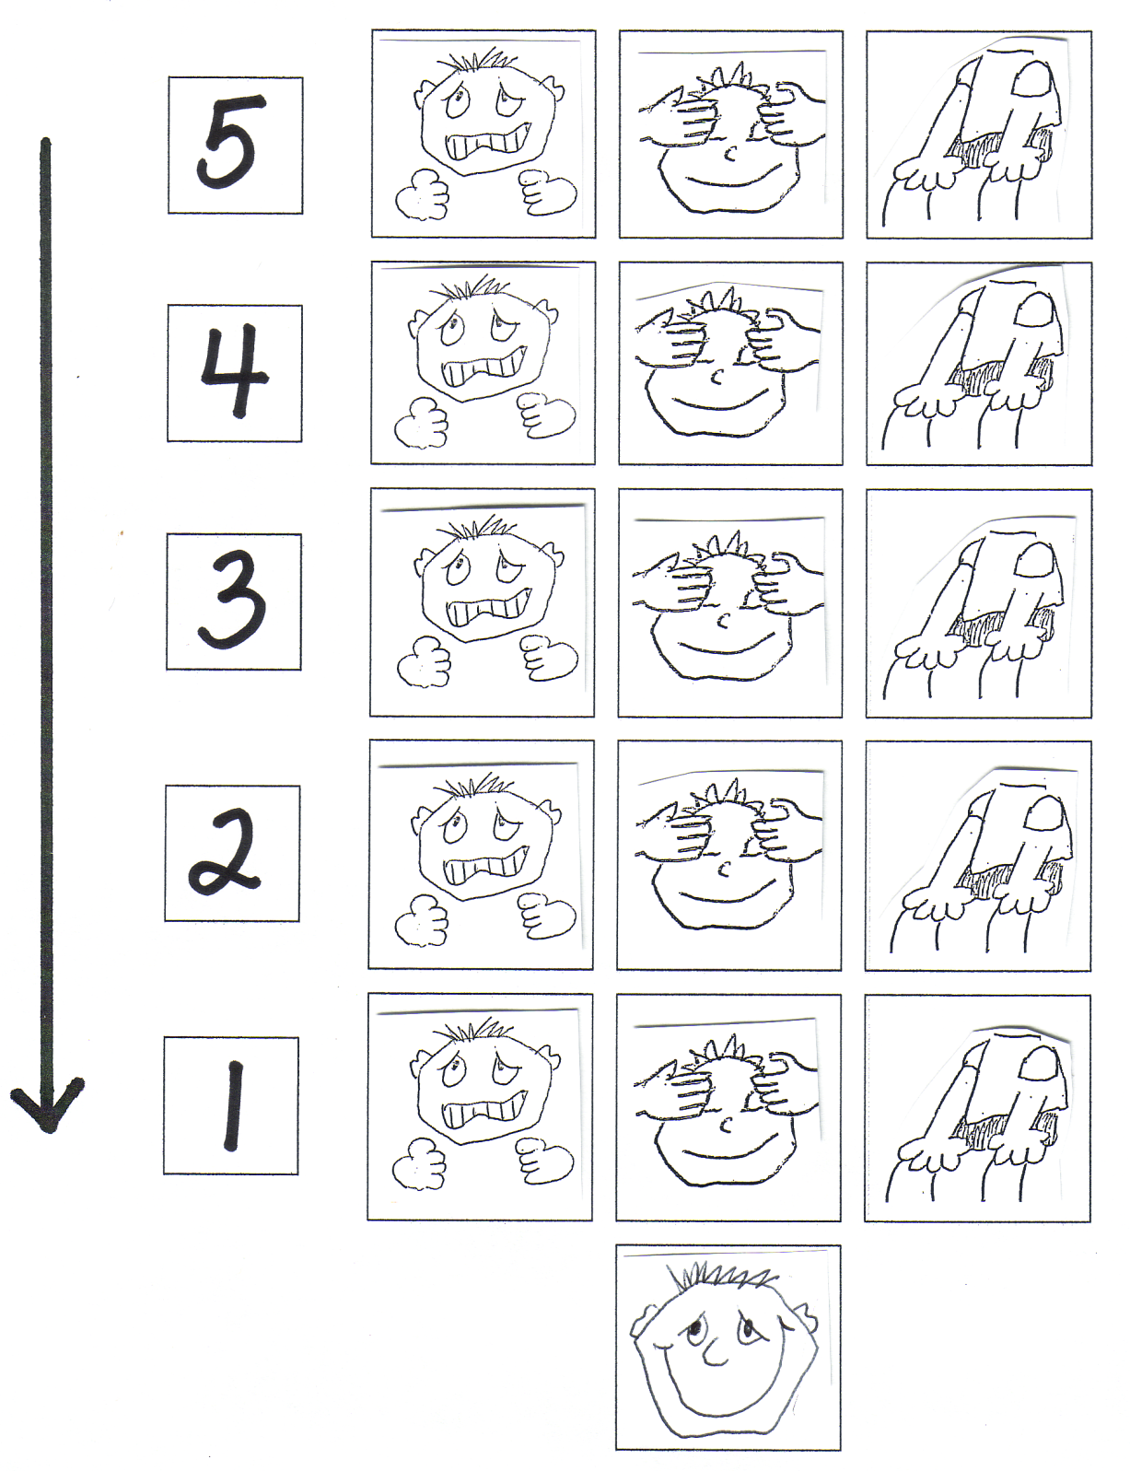
What is “habit memory”?
Habit memory – repetitive and over-
learned
Buron, Manns, Schultz and Thomas

Slide 21
Anxiety’s affect on the body – Help your student to recognize their own symptoms of stress and fear
Breathing fast
Butterflies in tummy
Tense muscles
Dizzy
Need to pee
Crying
Sweating
Stomachache
Shaky
Headache
Hot
Fidgetiness
Heart Rate up
Blushing/flushing

Slide 22
“The brain changes in response to patterned, repetitive experiences: the more you repeat something, the more engrained it becomes”.
Dr. Bruce Perry

Slide 24
What is it?
A pocket activity with examples of situations and environments for the student to rate on a 5-point scale
An interactive activity used to problem solve
Introduced first with a variety of situations and environments you know are really pleasant for the person or really unpleasant (1’s and 5’s)
You are getting input regarding the student’s perspective
If a student rates a situation or environment at a 4 or 5…it could mean that person needs more support during those times (recess, teasing, cafeteria, assemblies)

Slide 25
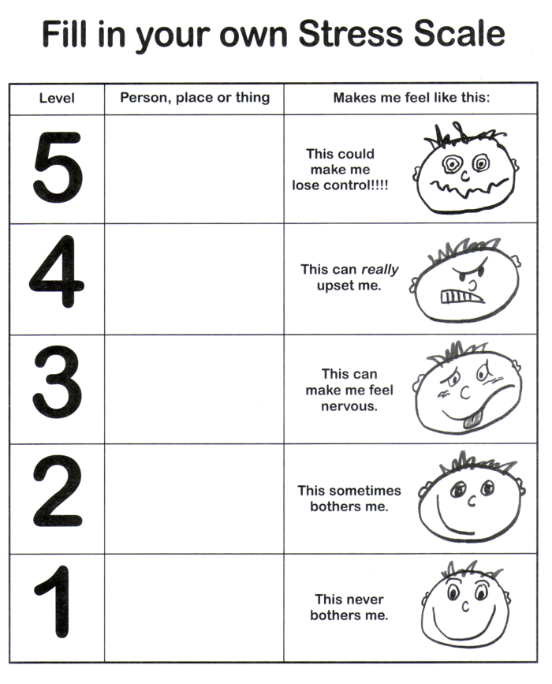

Slide 27
A 5 is Against the Law!
                Information about confusing topics that have caused problems for other teenagers and young adults.
Scales and activities to reinforce the information

Slide 28
Who is it written for?
Teens and young adults who:
  Have problems with personal space
  Who try to fit in but make social mistakes
  Who have pursued a relationship and that person accused them of harassment

Slide 29
How the workbook is organized
What is a 5-point scale?
How can it help you?
Example of social behavior from very informal social behavior (1) to Physically hurtful or threatening behavior (5)
How behavior changes as we get older (hugging rules)
Story example – good ideas to think about – activities for a small group – an example of how to think about the topic using a scale.

Slide 30
The Anxiety Curve
Based on the 5-Point Scale
Used in educational programming
Puts the emphasis on early signs of stress
Visually illustrates the need to “redirect” attention early (at a 2 or 3)
Stresses the need for all caregivers to understand the early signs of stress in their students and themselves

Slide 31
Have a system for objectively thinking about challenging behavior:
What is he doing that you wish he wasn’t?
What would you rather he do?
What skills does he need to do that?
How can you teach those skills?
Ross Greene

Slide 32
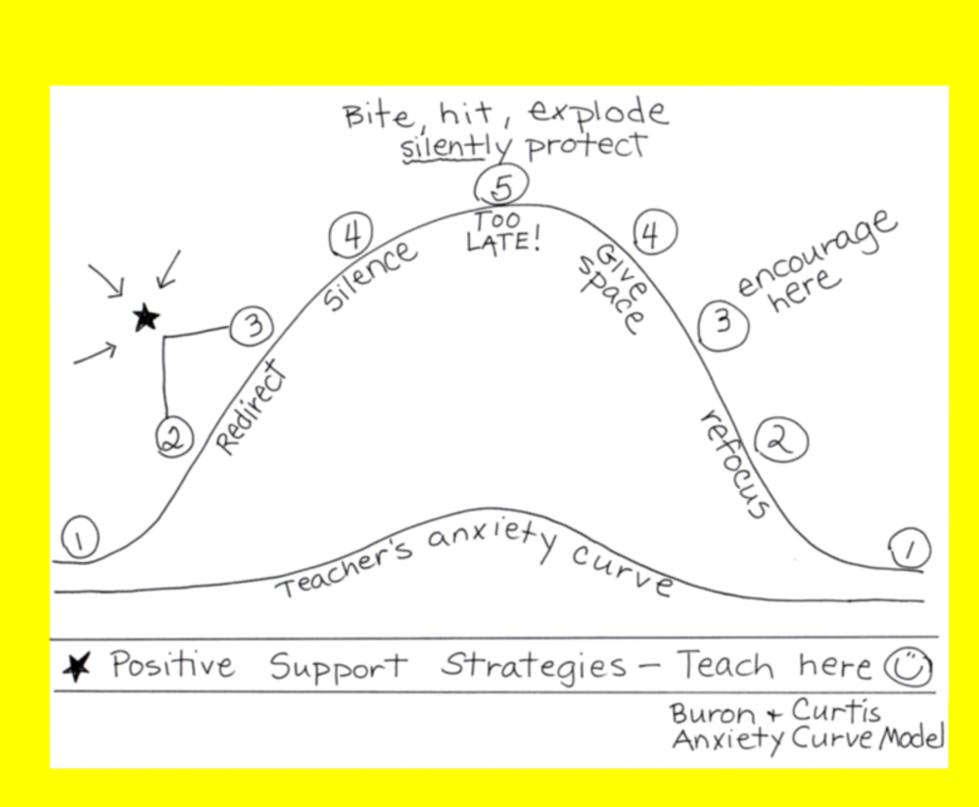

Slide 33
Why a 5 is never worth it:
The damaging effects of stress hormones (cortisol and adrenaline)
Repeatedly having to face stressful situations
Levels too high – too long is physically harmful – a need for relief.
This can create an imbalance in the immune and nervous systems.
Person can become susceptible to illness and problems sleeping
No teaching happens anyway.
We can’t leave stress management to chance.

Slide 34
Caregivers can reduce their own stress and student stress by showing compassion.
You don’t need to know why to be compassionate.

